Slide 1

Next Generation Nonclinical Protocol Development: An OpenStudyBuilder Discussion and Demonstration Opportunities for Pre-Clinical Protocol Automation
Society of Toxicology Meeting

Slide 2


Agenda
Introduction
Protocol Automation Needs
Solutions
Nonclinical vs Clinical
Collaboration
Questions & Answers
2

Slide 3

Introduction
3

Slide 4

Meet the Presenters
Experience
Presenter
Over 30 years of experience in life sciences
Former employee of the New York State Department of Health, Synthes USA, NYU Medical Center
Membership
Active member of CDISC SEND standards consortium
Active member of PhUSE / FDA Industry Collaboration
Bob Friedman
Chief Technologist & Chief Solution Architect
Education
Master of Engineering, Biomedical Engineering
Bachelor of Engineering, Biomedical Engineering

Slide 5


Meet the Presenters (online)
Experience
Presenter
Over 15 years of experience in life sciences (SAS, Web Technologies, ADAM, Define.xml and the TLF generation, Study evaluation processes, …)
Open Source Ambassador (www.glacon.eu/portal)
Membership
Community Manager of OpenStudyBuilder
Active member of PHUSE
Active member of CDISC Open Source Alliance (board member)
Katja Glaß
Open Source Consultant
Education
Diploma of Information Technology

Slide 6

Protocol Design Automation needs
Ensure a higher degree of end-to-end consistency
Have built-in compliance with external and internal standards
Facilitate more automation and content reuse
Share electronically the nonclinical protocol / study
Between Pharma's and CROs
To regulatory bodies
Do so in a manner that is
Computer readable for system to system exchange
Human readable to turn into approval formal protocol
Amendments must be evident
6

Slide 7
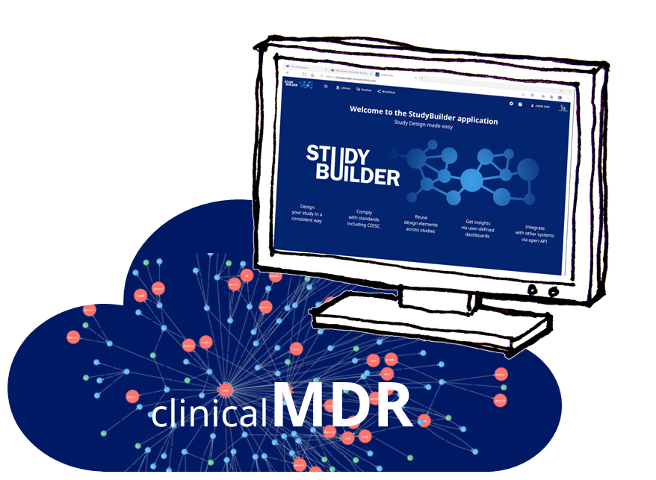
What is the OpenStudyBuilder …
OpenStudyBuilder is an open source solution provided by Novo Nordisk® which is looking for collaborations.
The OpenStudyBuilder comprises three elements:
Clinical Metadata Repository (MDR) and Study Definition Repository (SDR) (central repository for all study specification data)
OpenStudyBuilder application (web-based user interface)
API layer (allowing interoperability with other applications) (DDF API Adaptor – enabling DDF SDR Compatibility)
OPEN
7

Slide 8
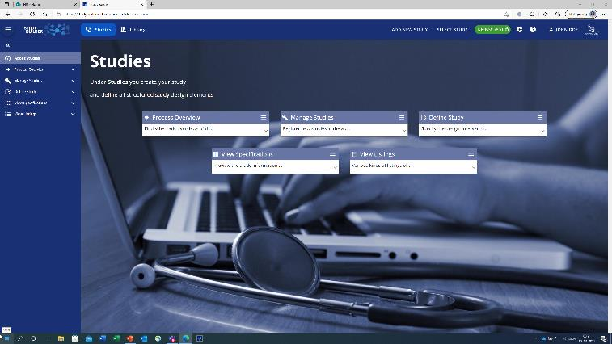
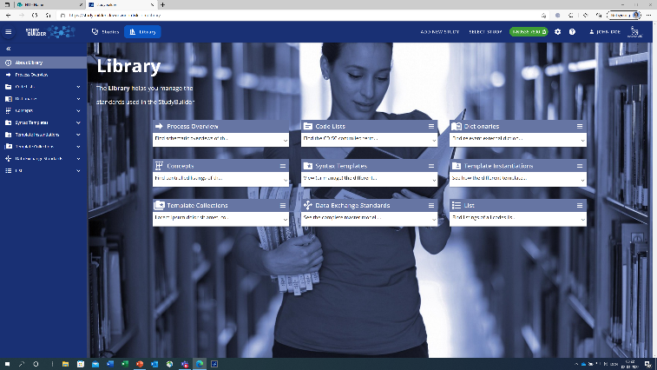
The OpenStudyBuilder includes:
A Studies part for specification of studies (incl. disease area and study type, objectives and endpoints, population and eligibility criteria, study compounds and other interventions, study design, arms and visits, schedule of activities and associated procedure and assessment instructions)
A Library part for maintenance of terminology standards (incl. CDISC controlled terminology, relevant parts of external dictionaries for medical terms, pharmacological classes, units, a detailed compound library, a granulated library of activity terms) as well as syntax templates for cross-study and cross-project harmonisation)
An underlying knowledge database (enabling complex queries and visualisations for aggregation of information and showing how things are connected end-to-end)
Notes:
Voice over Trial Domain and Protocol related information

Slide 9
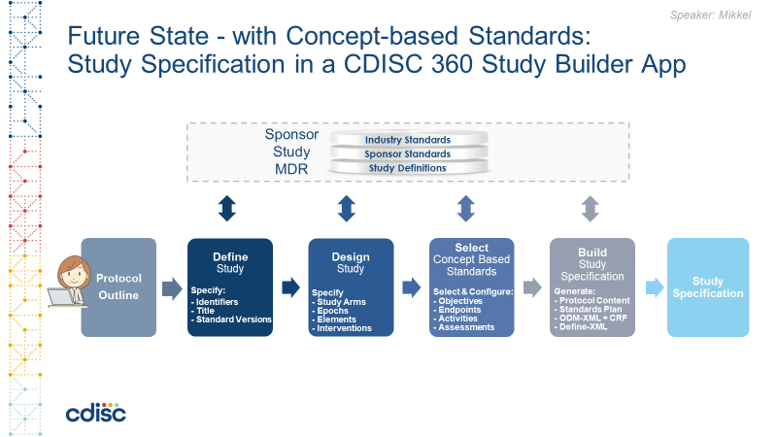
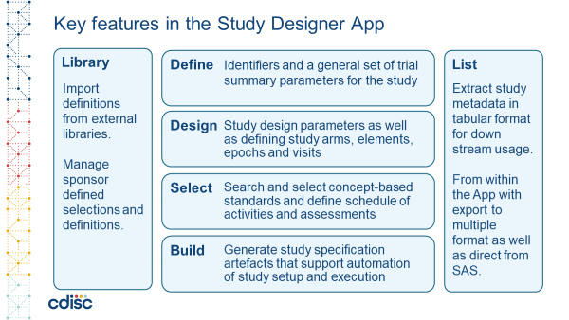
OpenStudyBuilder is being built as an open-source MDR and SDR solution based on the CDISC 360 POC
Project collaborates with CDISC, TransCelerate DDF and suppliers
https://www.cdisc.org/cdisc-360

Slide 10
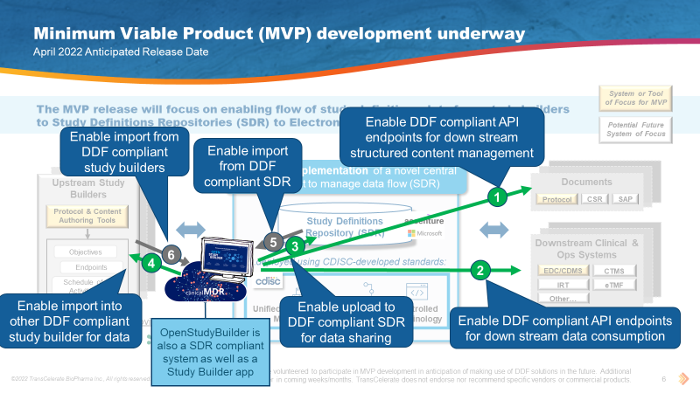
OpenStudyBuilder will also be DDF Compatible
https://transcelerate.github.io/ddf-home/
Notes:
At the DDF connectathon we created and demonstrated different use cases which are available as videos.

Slide 11
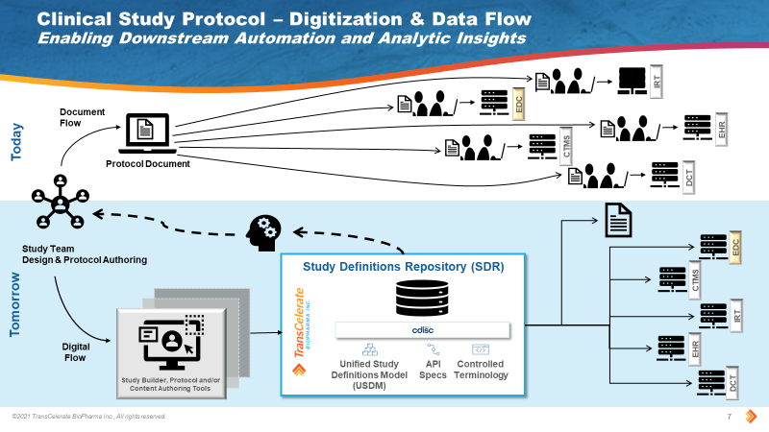
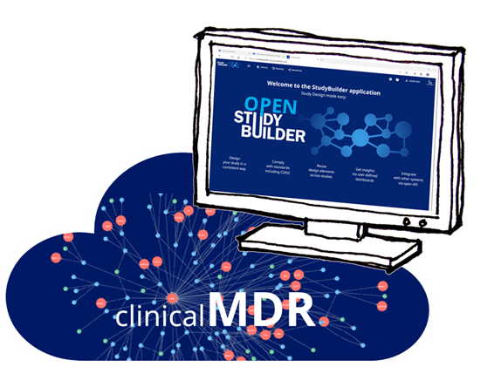
DDF is moving away from Document focused processes to Connected Data Driven processes
11

Slide 12
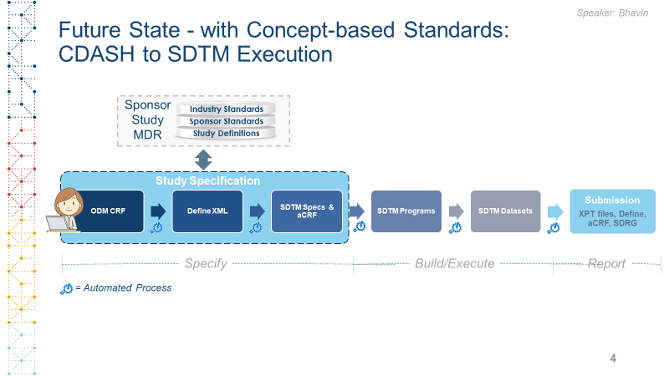
To apply concept-based data standards end-to-end
From protocol preparation through study conduct to reporting and submission of applications to health authorities
and with reference to externally-compliant concept-based data standards and terminology

Slide 13

Open-Sourced
Shared as open source project in Q3 2022
https://novo-nordisk.gitlab.io/nn-public/openstudybuilder/project-description/
Listed in COSA (CDISC Open Source Alliance)
https://cosa.cdisc.org/directory/openStudyBuilder
Seek to actively collaborate with CDISC, TransCelerate DDF, peers and vendors
13

Slide 14
Protocol
14

Slide 15
OpenStudyBuilder Demo
15

Slide 16
OpenStudyBuilder Demo
16

Slide 17
Differences between Non clinical and Clinical
17

Slide 18
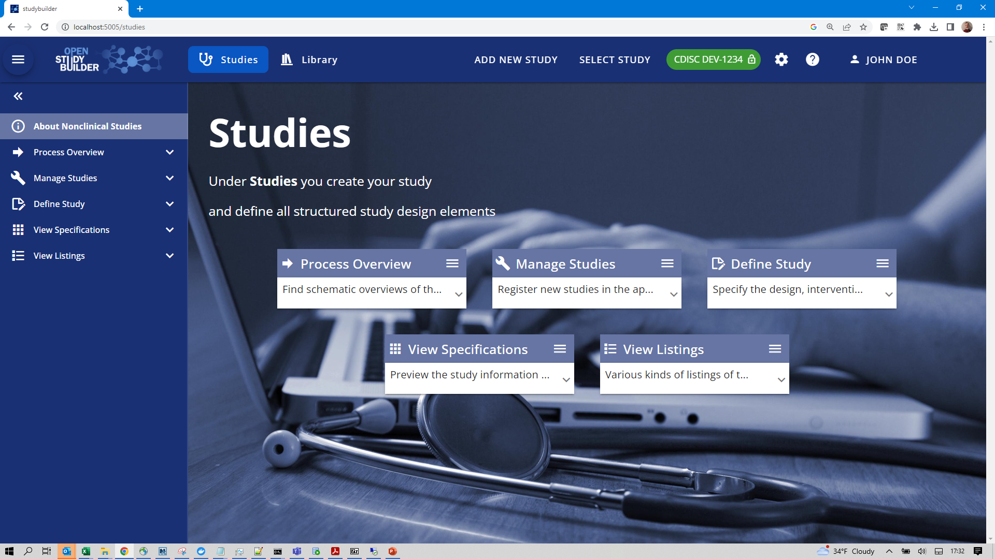

Slide 19
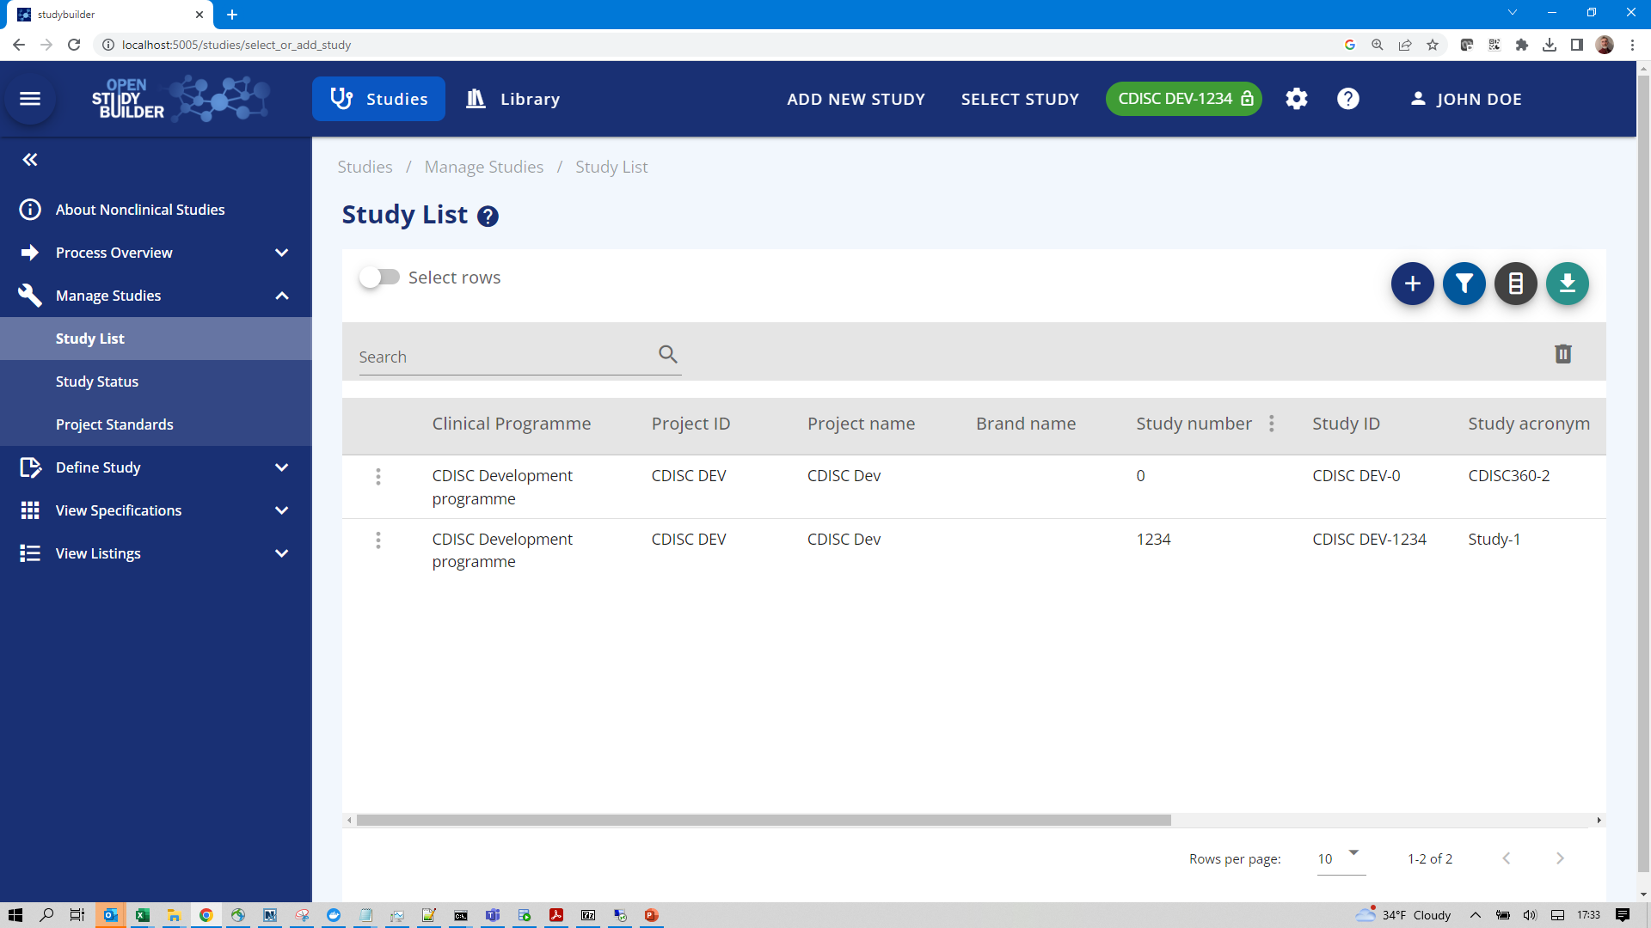

Slide 20
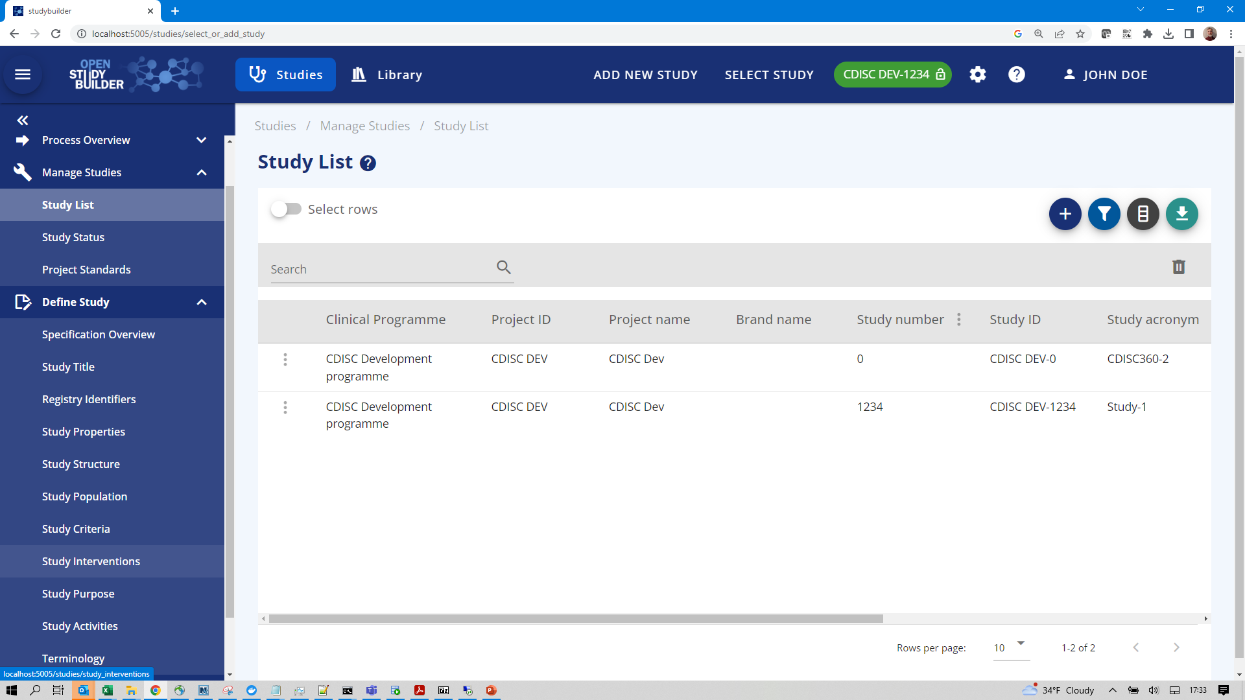

Slide 21
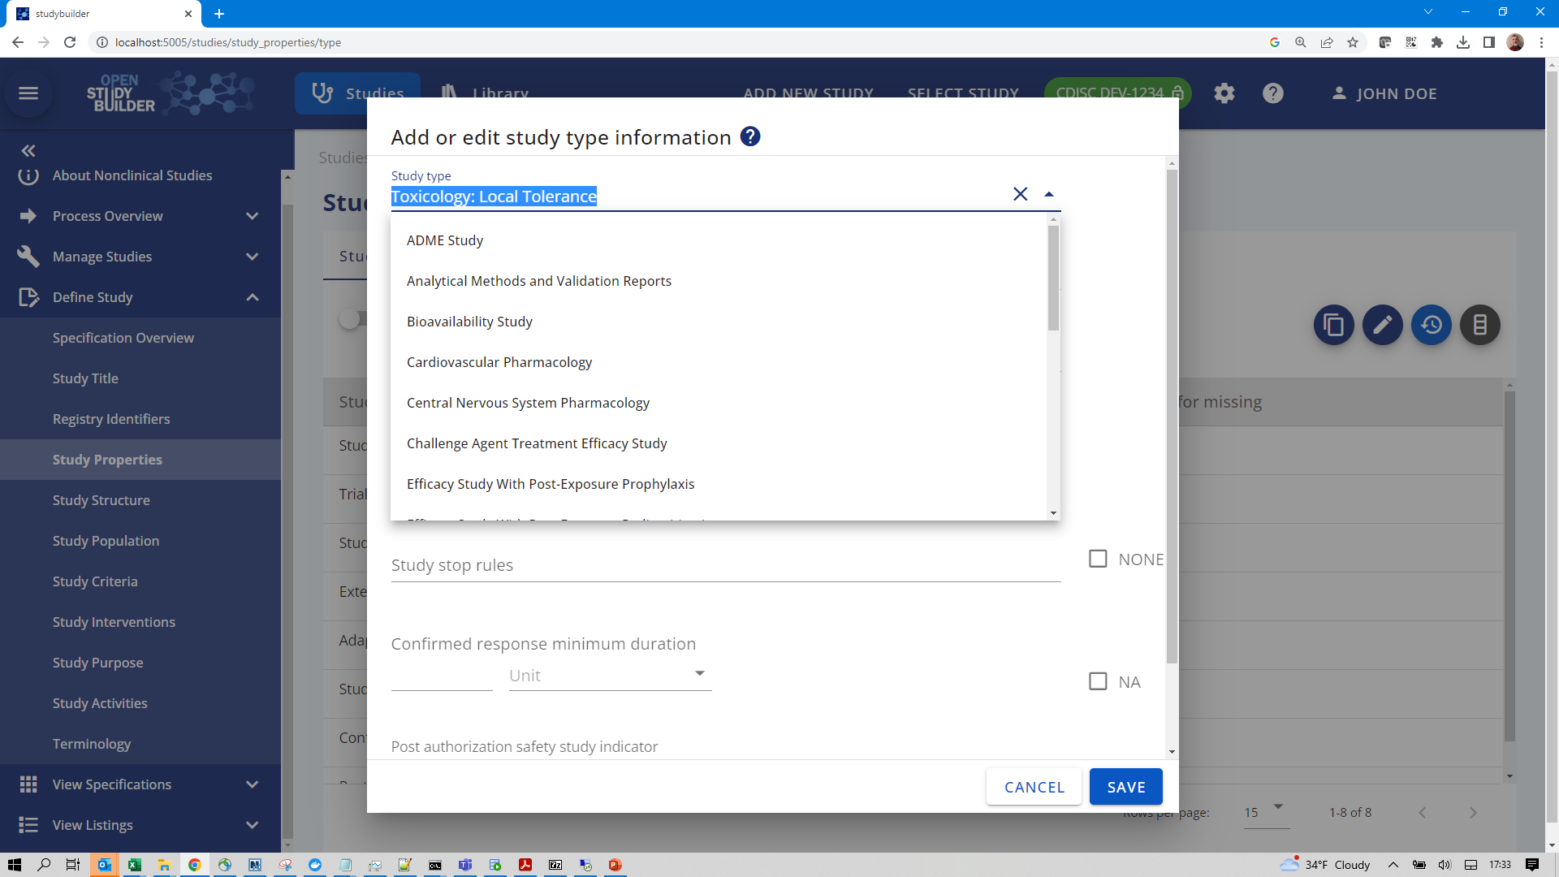

Slide 22
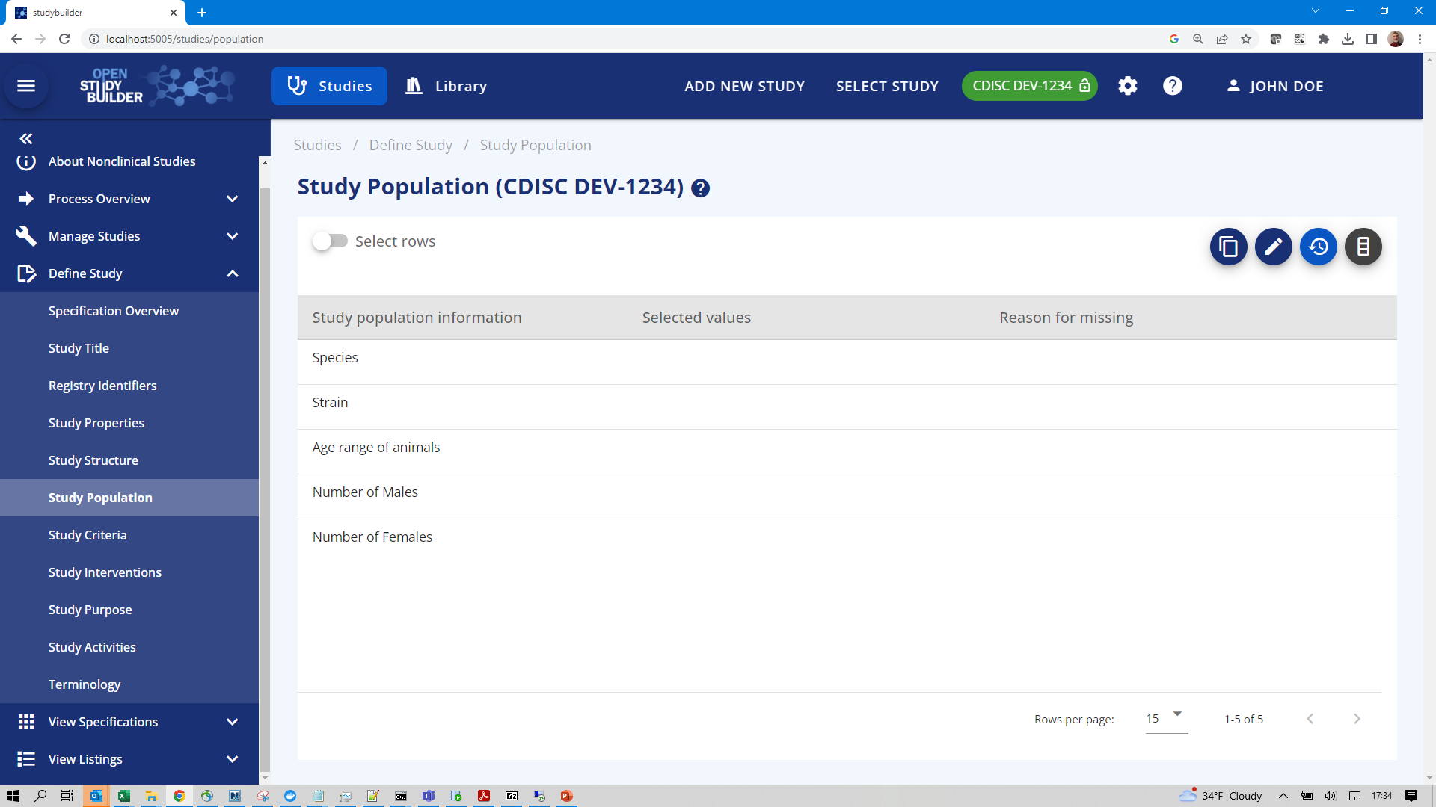

Slide 23
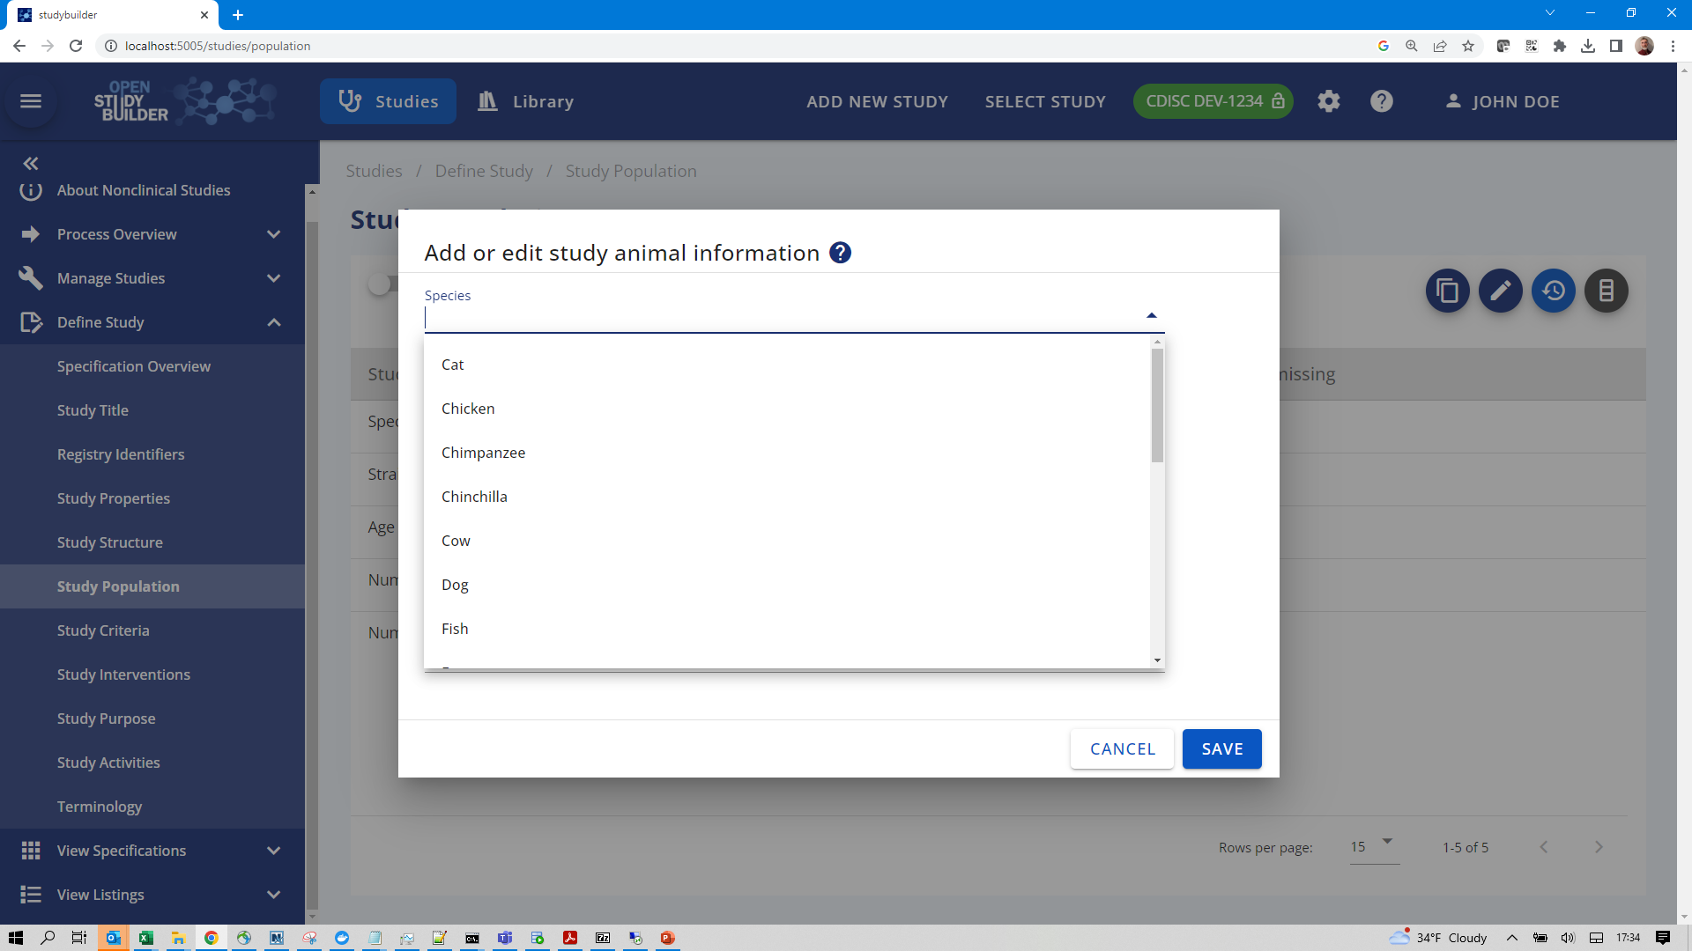

Slide 24
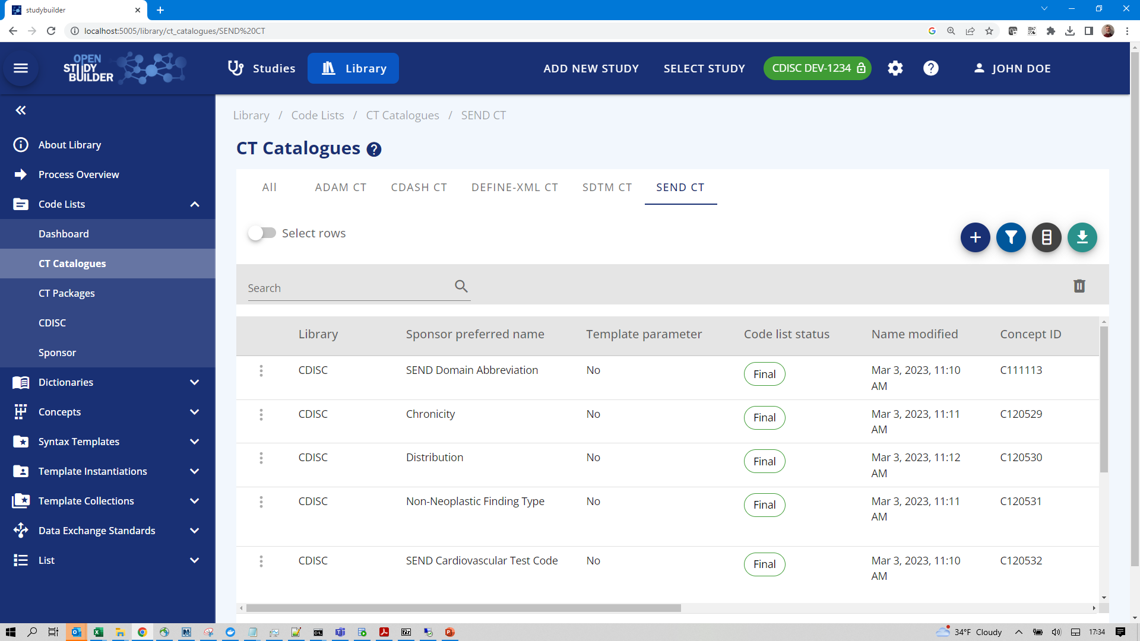

Slide 25
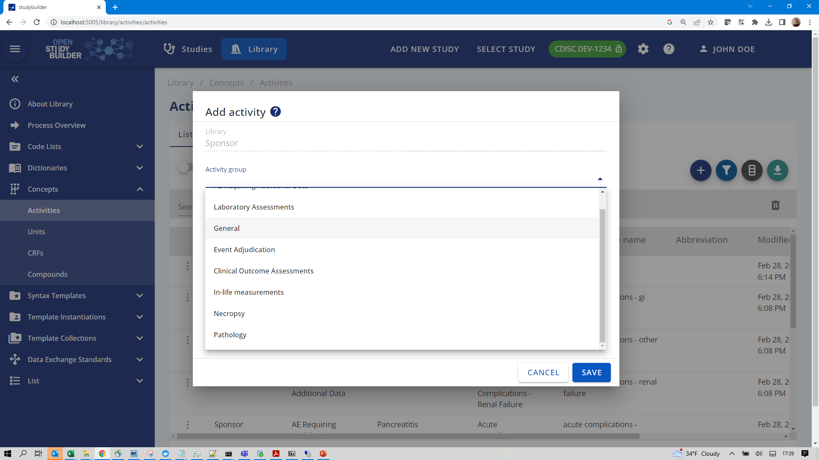

Slide 26
Automation Opportunities
26

Slide 27
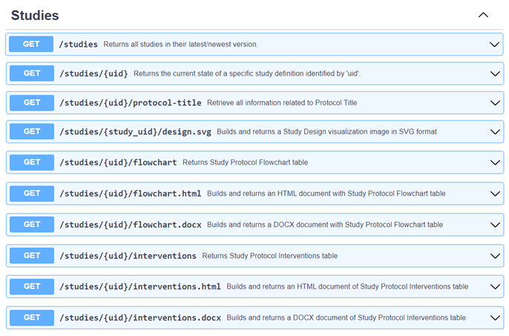
Getting Data
All data accessible through APIs
Tools can be automated

Slide 28
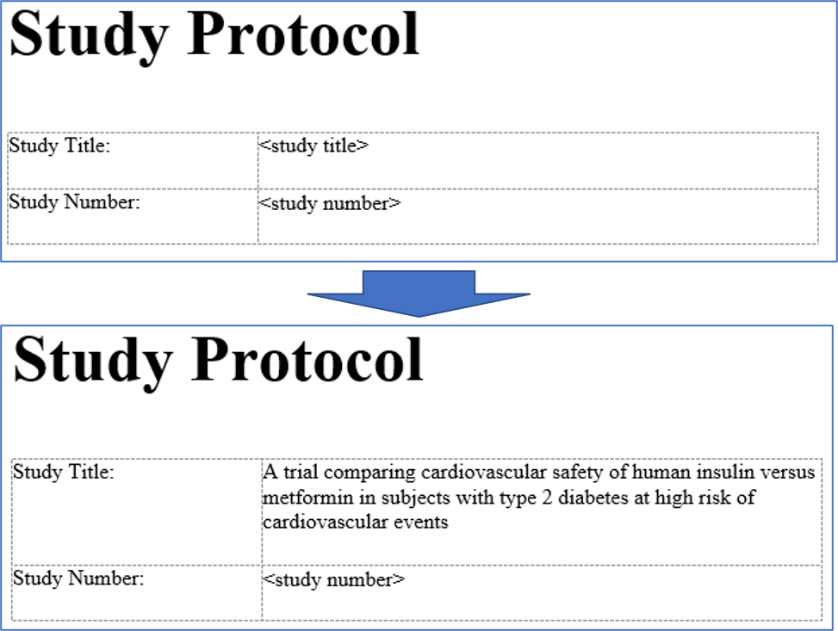

Protocol Automation
Example:
Word-Programming in VBA
Word-Programming in R
Word-Programming in Python
…
API to get
Study Design as SVG
Flowchart as HTML or DOCX
Interventions as HTML or DOCX
API

Slide 29
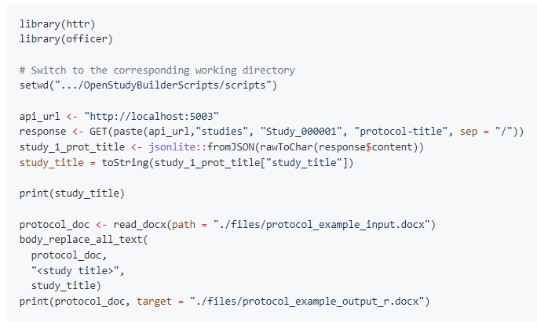
Protocol Automation
Examples available

Slide 30
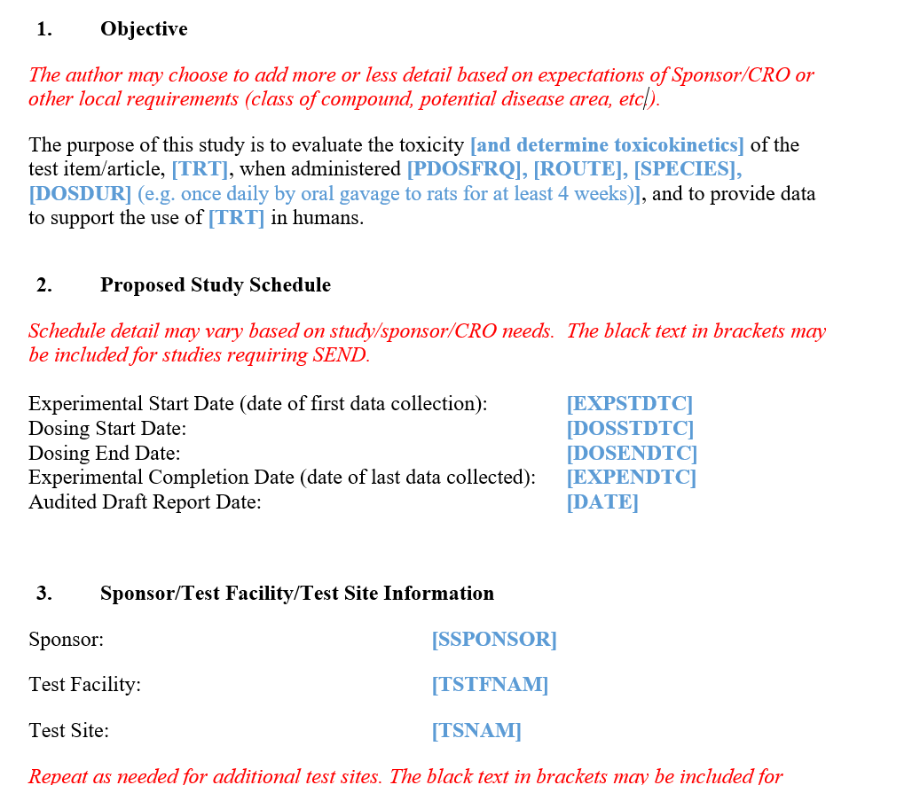
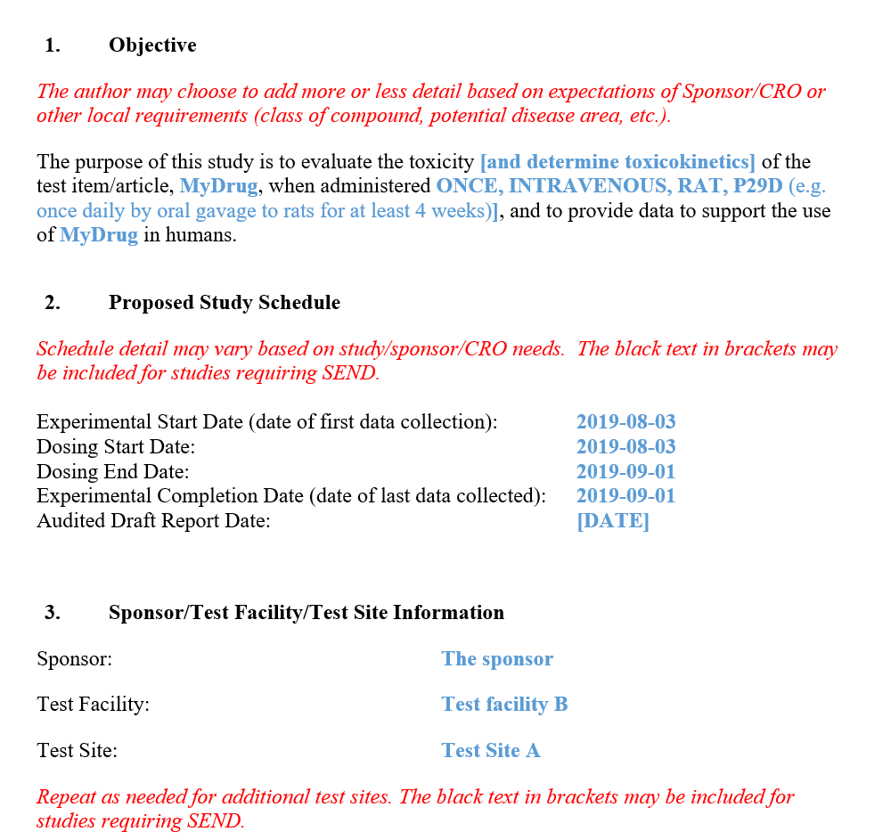


Protocol filled in from underlying data
30

Slide 31
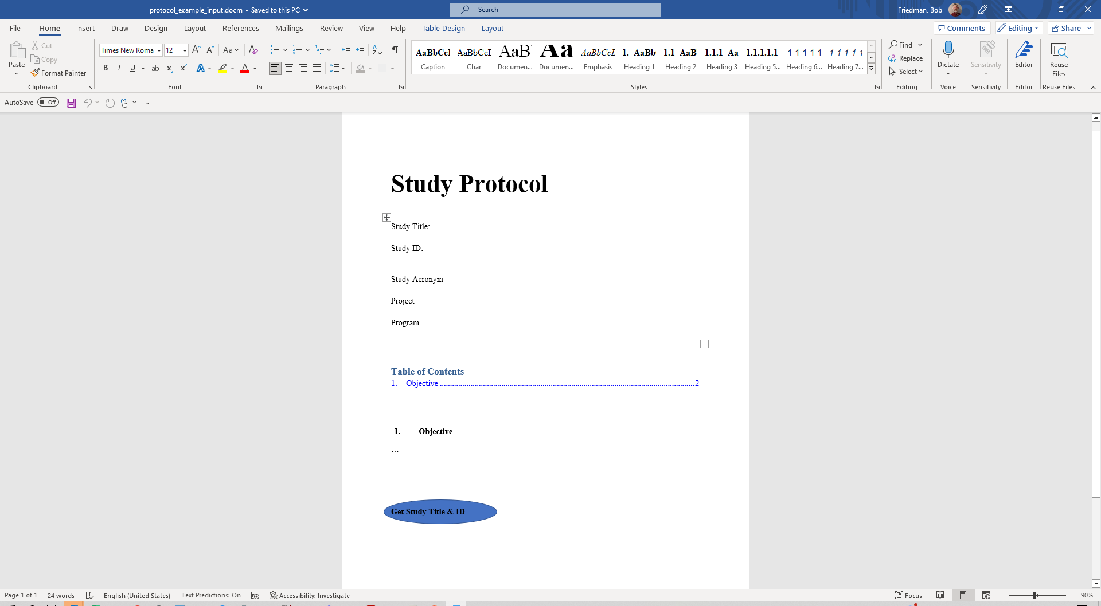

Slide 32
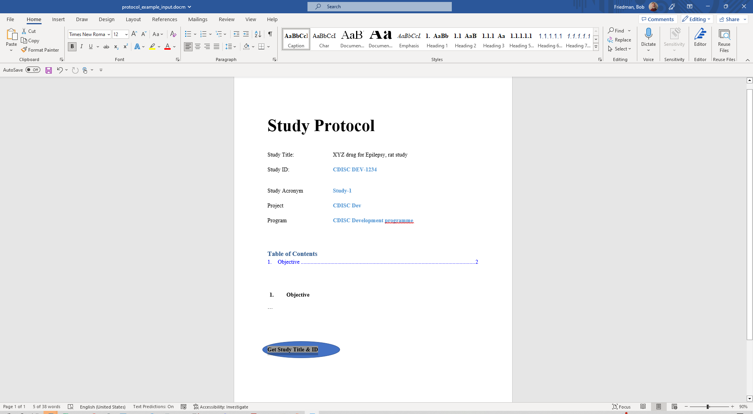

Slide 33
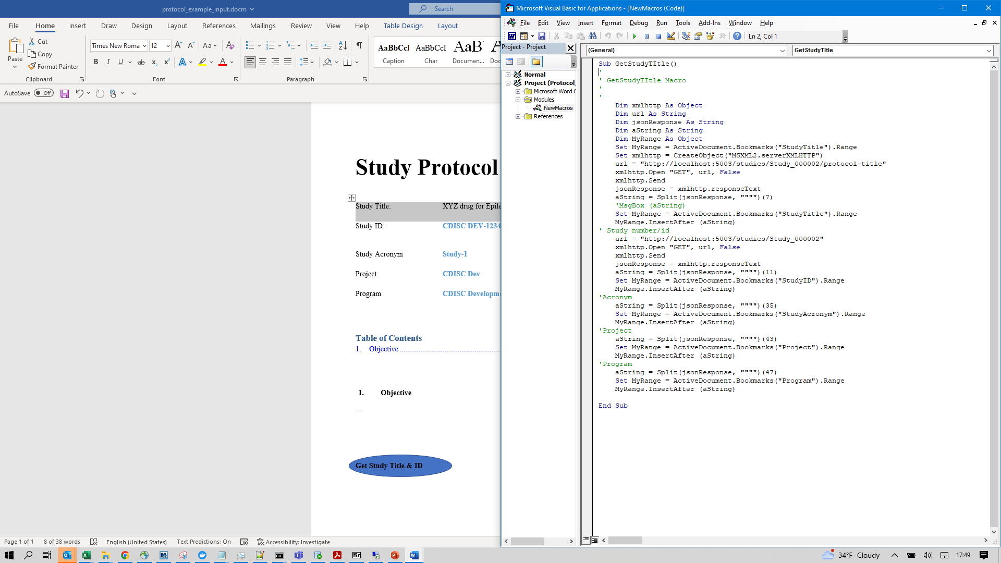

Slide 34
Getting Started
34

Slide 35
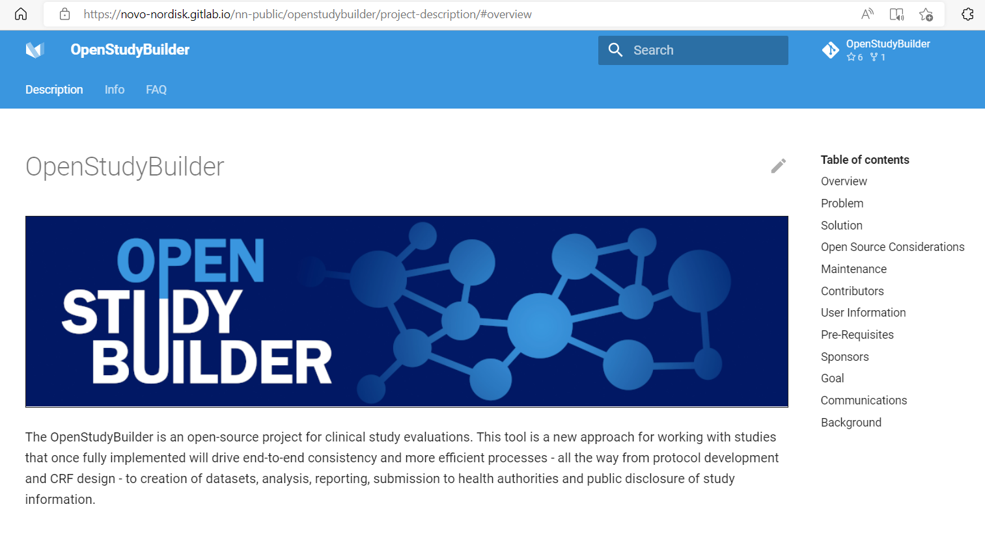
How do I get started on OpenStudyBuilder?
https://novo-nordisk.gitlab.io/nn-public/openstudybuilder/project-description/
35
35

Slide 36
Starting with OpenStudyBuilder
Neo4j Sandbox to play around
Browse, test and investigate functionality
Checkout Biomedical Concept (linked data browser)
Local installation (free) or Custom/dedicated environment
API usage to upload/download custom data
Load trial domains
Browse “your” data
36

Slide 37



Collaboration Opportunities
BioCelerate Protocol Template Project
OpenStudyBuilder community
PHUSE eProtocol project
Metadata standards
37

Slide 38

Collaboration Opportunities
Enhance OpenStudyBuilder for NonClinical usage
Create common additional standards “templates”, e.g. for endpoints, scope
Common tools, processes and guides
Protocol automation
CRF
What to do on distressed animals
How to describe statistical planning

Slide 39

Expectation & Reality
Novo Nordisk is continuously enhancing the tool and is looking for collaborations
Pre-clinical does not have priority on internal development, don’t expect specific updates by them
Support only through community or vendors
Appreciate and include documentation from everyone
If you want quick progress on developments, you have to invest, either personal or vendors
Pre-clinical version:
Ideally there would be a “configuration” for pre-clinical, no additional parallel development

Slide 40
Links
Project Homepage
https://novo-nordisk.gitlab.io/nn-public/openstudybuilder/project-description/
Source Repository
https://gitlab.com/Novo-Nordisk/nn-public/openstudybuilder/OpenStudyBuilder-Solution
COSA Homepage
https://cosa.cdisc.org/
Newsletter (LinkedIn)
https://www.linkedin.com/newsletters/openstudybuilder-6990328054849916928/
Sandbox to request access
Mail openstudybuilder@neotechnology.com – Subject “Request Sandbox access”
User Scripts & Experiences Documentation
https://github.com/KatjaGlassConsulting/OpenStudyBuilderScripts

Slide 41
Thanks! Questions?

Slide 42


Thank You
Bob Friedman
Chief Technology Officer, Xybion
Email: bfriedman@xybion.com
Katja Glaß
Katja Glass Consulting
Email: katja.glass@glacon.eu
OpenStudyBuilder Project
https://novo-nordisk.gitlab.io/ nn-public/openstudybuilder/project-description/
www.xybion.com
North America
New Jersey – HQ
105 College Road East Princeton, NJ 08540 Phone: 609-512-5790
Fax: 609-482-3823
Toll Free: 844-291-4430
EMEA
Herriotstrasse 1 60528 Frankfurt Germany +49 (0) 696 773 3456
Canada
400 Jean-Lesage Boulevard Suite 348 Quebec City, QC, Canada G1K 8W1 +1-418-525-0606
India
1st Floor, TEK TOWERS No.11, Old Mahabalipuram Road, Chennai, 600097 +91-44-4283-3115
India
91 Springboard Business Hub Private Limited.
Plot No-44, Phase I Kavuri Hills,
Hyderabad, Telangana 500033.

